Slide 1
Middle Eastern and North African History
An Overview

Slide 2
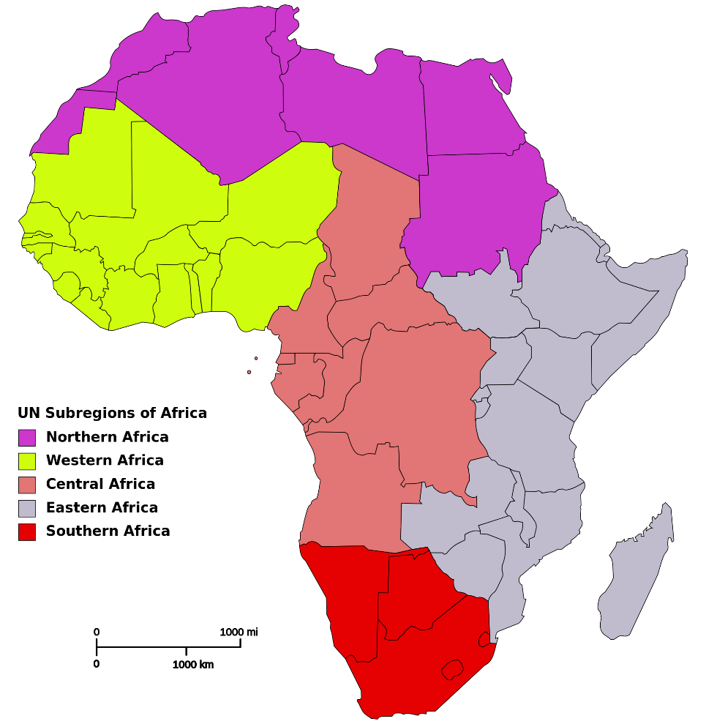
Regions of Africa

Slide 3
Major Historical Periods of Africa
Ancient Period - prior to 8th century CE
Medieval Period - 8th century-early 19th century
Colonial Era - ca. 1885- ca. 1950 CE
Post-Colonial Era - ca. 1950 CE – present

Slide 4
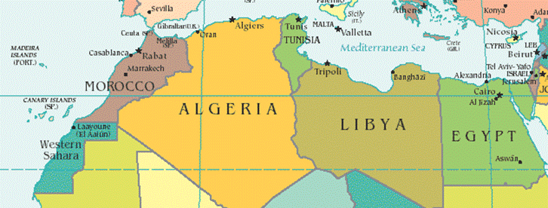
Map of North Africa

Slide 5
Major North African Civilizations
Kingdoms of Egypt and Kush 3500 BCE-600 CE

Slide 6
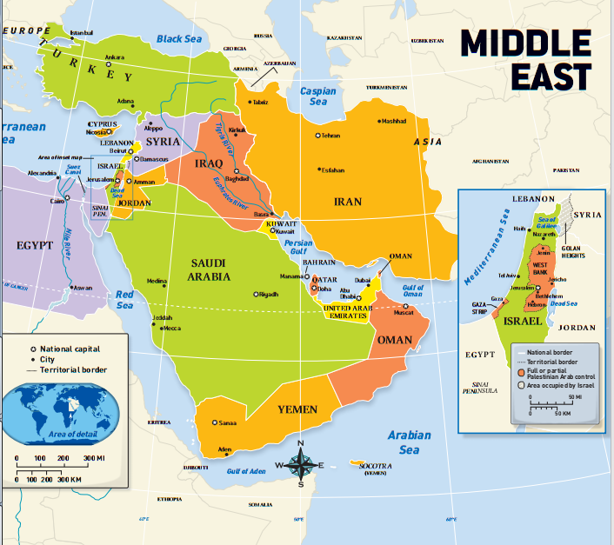
Map of the Middle East

Slide 7
Geographic Regions of the Middle East
North Africa
The Arabian Peninsula
The Persian Gulf

Slide 8
Major Historical Periods and Civilizations of the Middle East
Mesopotamia
  Sumer - ca. 3500 BCE-2027 BCE
  Akkad - 2340 BCE-2180 BCE
  Babylon - ca. 1900 BCE-ca. 1550 BCE
Egypt - ca. 3100 BCE-525 BCE
  The Old Kingdom - 2686 BCE-2181 BCE
  The Middle Kingdom - 2040 BCE-1786 BCE
  The New Kingdom - 1552 BCE-525 BCE

Slide 9
Major Historical Periods and Civilizations of the Middle East (continued)
Hebrews – 1800 BCE-70 CE
Hittite - ca. 1450 BCE-1180 BCE
Assyria - ca. 850 BCE-612 BCE
Persia - ca. 550 BCE-327 BCE
The Byzantine Empire – 324-1160 CE
Age of Muhammad - 600-632 CE
Islamic Empire - 632-1517 CE

Slide 10
Major Historical Periods and Civilizations of the Middle East (continued)
The Turks 900-1250 CE
The Mongols 1200-1400 CE
The Ottoman Turks 1250-1922 CE

Slide 11
The Islamic Empire
Post-Muhammad Years 632-661 CE
  Death of Muhammad 632 CE
  The Four Rashidun (“Rightly Guided”) Caliphs 632-641 CE
Umayyad Dynasty 661-750 CE
  Capital moved to Damascus 661 CE
Abbasid Dynasty 750-1250 CE
  Capital moved to Baghdad 762 CE
  Seljuk Turk Empire 1050-1250 CE
  Saladin founds Ayyubid Dynasty 1169-1250 CE
Imperial Decline 1250-1517 CE
  Mongols sack Baghdad 1258 CE
  Defeat of Mongols 1260 CE
  Ottoman Turks conquer Egypt and Syria 1517

Slide 12
Middle Eastern and North African Historians
Atâ-Malek Juvayni 1226-1283 CE
Major Work: Tarīkh-i Jahān-gushā (History of the World Conqueror)
He wrote a history of the Mongol Empire

Slide 13
Middle East and North African Historians (continued)
Muhammad Ibn Battuta 1304-1368 or 1369 CE
Major Work: Rihla (The Travels)
He traveled extensively through Africa, the Middle East, and Asia

Slide 14
Middle Eastern and North African Historians (continued)
Ibn Khaldun 1332-1406 CE
Major Work: Kitab al-’Ibar (Book of Lessons)
He is considered one of the founders of modern scientific history.
History should downplay the role of divinity and emphasis human activity.
Human beings are motivated not by religious or idealistic impulses, but by status and group identity.

